Slide 1

CS 513 B
Mental Health Analysis
Guided By: Prof Khashayar Dehnad

Slide 2




Team Members
SHRADDHA KUMBHAR
CWID: 10476875
ANCHAL BANSAL
CWID: 10478699
AVANI CHHETA CWID: 10471861
SAVLEEN KAUR CWID: 10476867

Slide 3
Problem Statement
https://www.kaggle.com/datasets/osmi/mental-health-in-tech-survey?datasetId=311&searchQuery=decision
This dataset is from a survey that measures attitudes towards mental health and frequency of mental health disorders in the tech workplace.
Using the algorithms, we would try to analyze if a person would seek mental health treatment

Slide 4
Data Set Explanation
Dataset (survey.csv) consists of 27 columns with 1260 records.
Dataset has plenty of columns like self employed, leave etc which will help determine if the user will seek help or not
The task is to classify if the user will seek any mental health treatment or not.

Slide 5
Data Fields
Data Field | Description
Timestamp | Date and Time of data inserted
Age | Age of the employee
Gender | Gender of the employee
Country | Country where the employee lives
State | State where the employee lives
self_employed | If the employee is self-employed or not
family_history | Does the employee have any family mental health history
treatment | Has the employee sought help or treatment
work_interfere | If work interferes in case employee has mental health condition
no_employees | Number of employees the company or organization of that employee has
remote_work | If the employee works remotely at least 50% of the time
tech_company | If the organization is a tech company or not
benefits | If the employer provides mental health benefits
care_options | Is the employee aware of the mental health options provided by his employer

Slide 6
wellness_program | If employer has ever discussed mental health as part of an employee wellness program
seek_help | If employer provide resources to learn more about mental health issues and how to seek help
anonymity | Employee anonymity protected, if employee has chosen to take advantage of mental health or substance abuse treatment resources
leave | Is it easy for employee to take medical leave for a mental health condition
mentalhealthconsequence | Discussing a mental health issue with your employer would have negative consequences
physhealthconsequence | Does the employee think that discussing mental health with his employer would have negative impacts
coworkers | Is the employee willing to discuss his mental health with his coworkers
supervisor | Is the employee willing to discuss his mental health with his direct supervisor
mentalhealthinterview | Is the employee comfortable enough to discuss mental health during an interview with a potential employer
physhealthinterview | Is the employee comfortable enough to discuss physical health during an interview with a potential employer
mentalvsphysical | If the employer takes mental health as seriously as physical health
obs_consequence | If the employee has heard or observed negative consequences for coworkers with mental health conditions
comments | Any additional notes or comments

Slide 7
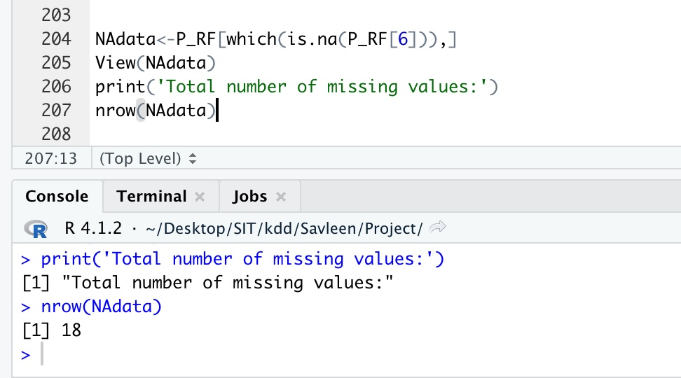
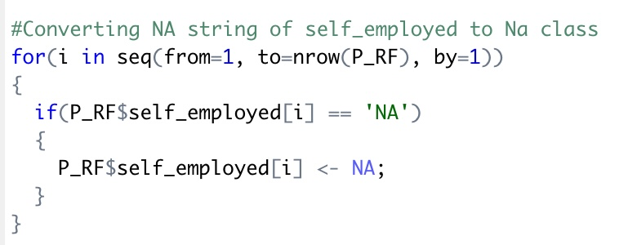
Exploratory Data Analysis- self_employed
Only self_employed column had NA values in the form of string.
Other columns were free from null/NA values
We converted those NA string values to NA class and then omitted them

Slide 8
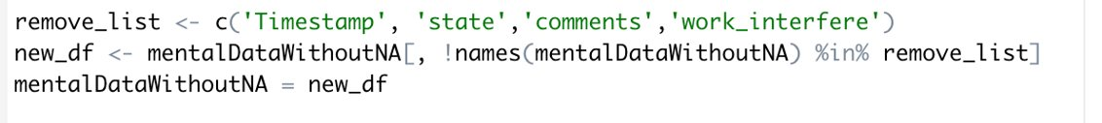
Exploratory Data Analysis- Irrelevant columns
Removed the irrelevant columns – Timestamp, State, Comments, Work_Interfere
Factored all the character data to feed into model

Slide 9
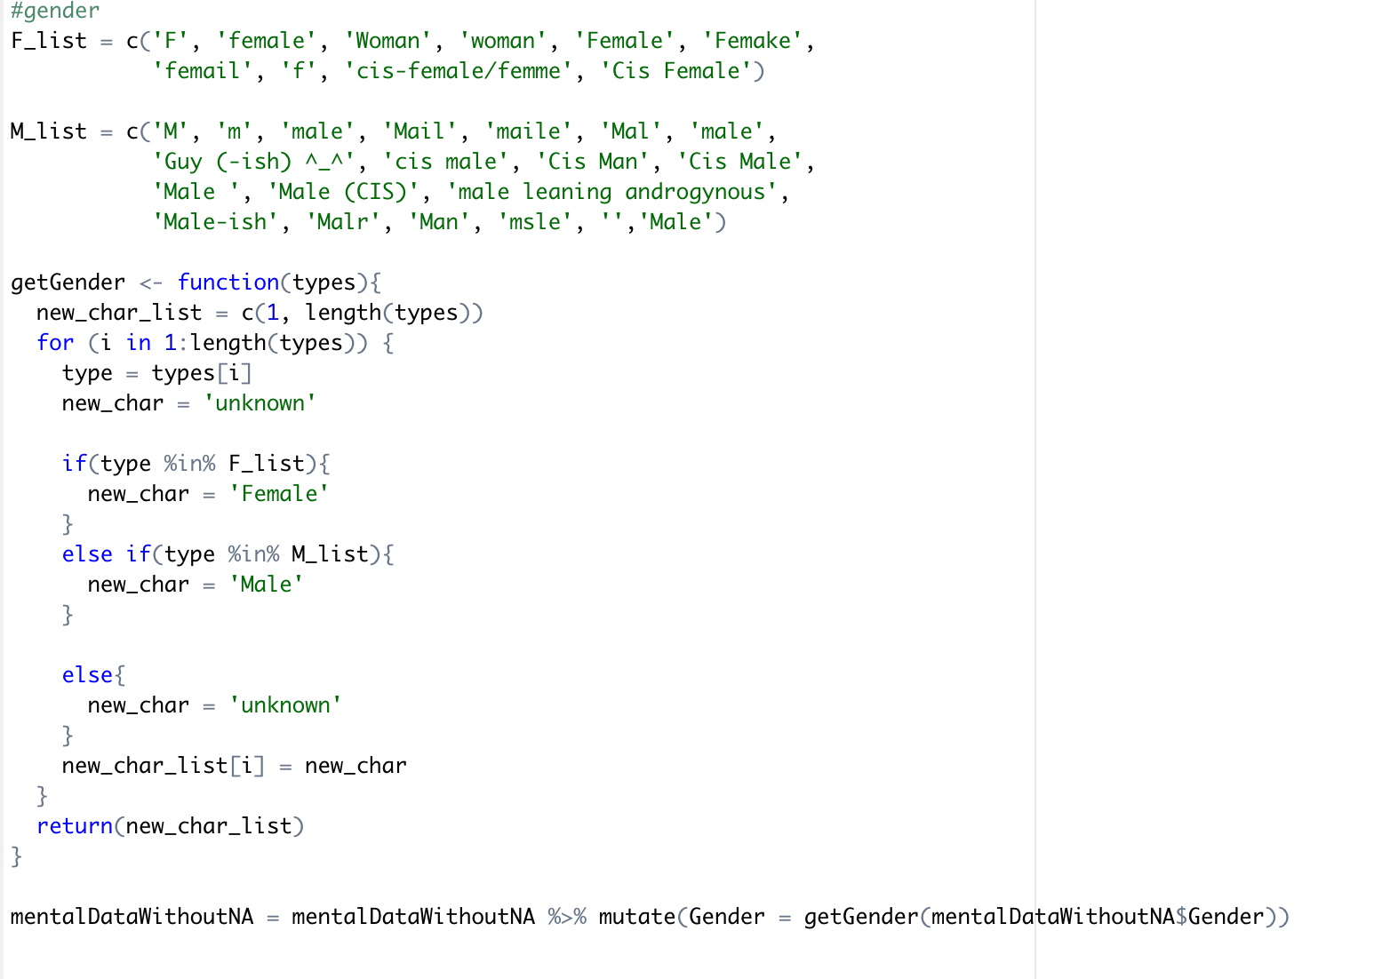
Exploratory Data Analysis - Gender
Cleaned the gender column by categorizing the male and female values entered in different forms - 'Female' and 'Male' and the rest of data as Unknown.

Slide 10
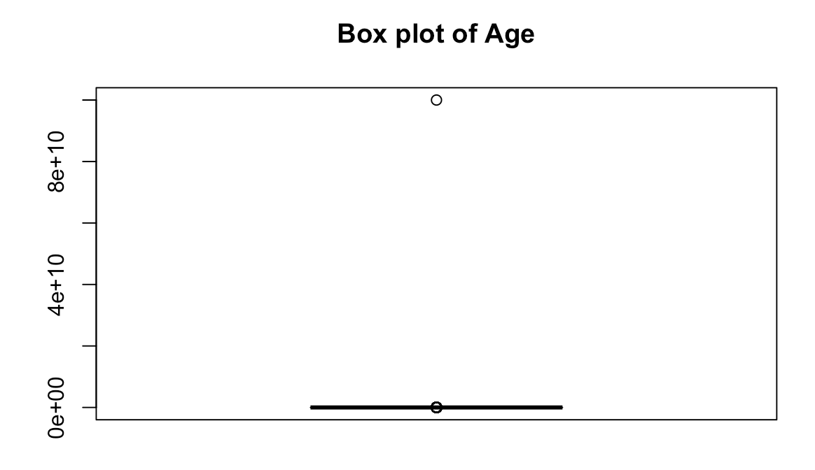
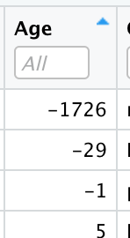
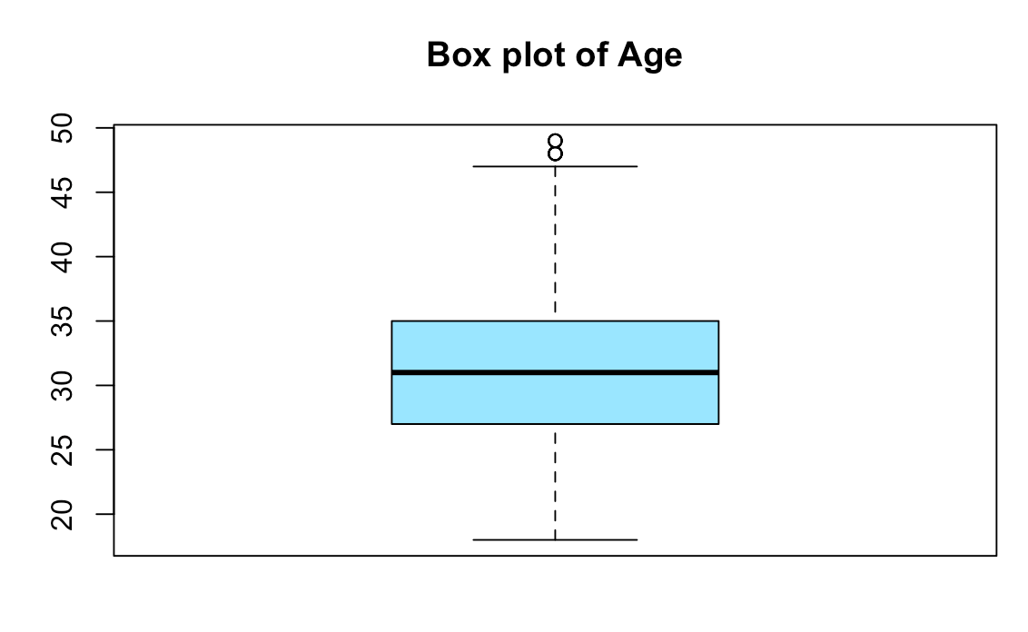
Exploratory Data Analysis - Age
Before EDA , we had outliers in age
We removed the outliers by taking the first and third percentile and removed the data that lies outside these quartiles

Slide 11
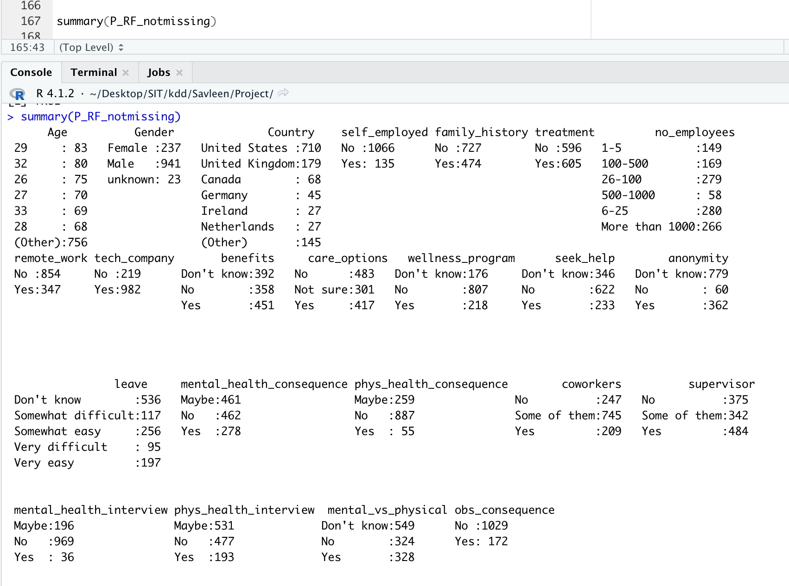
Exploratory Data Analysis
Our summary of the dataset after cleaning the dataset looks like this

Slide 12
Models we have used
KNN
Decision Tree
Random Forest
Naïve Bayes
Logistic Regression
SVM

Slide 13
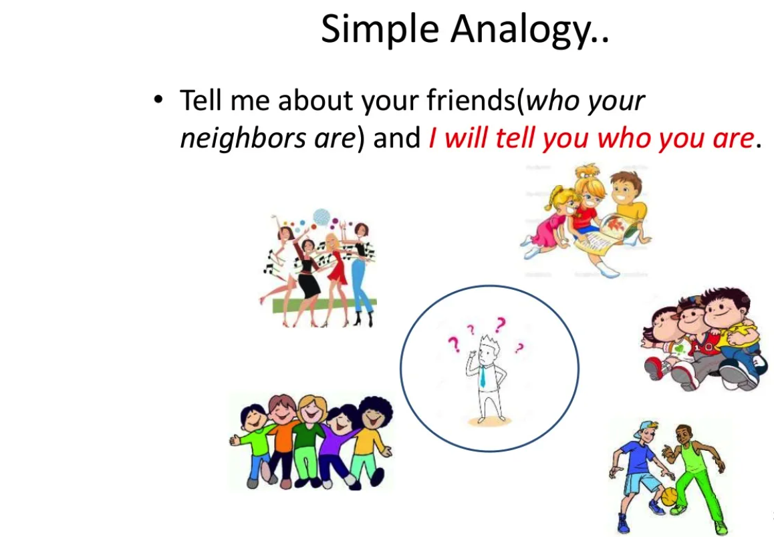
KNN
KNN is powerful classification algorithm used in pattern recognition
K nearest neighbors stores all available cases and classifies new cases based on similarity measure(example : distance function)
An object is classified by a majority votes for its neighbor classes
It is simple and intuitive algorithm

Slide 14
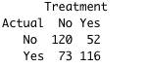
ACCURACY 65.37396
ERROR-RATE 0.3462604
Confusion Matrix

Slide 15
NAÏVE BAYES
Naive Bayes is a classification technique based on Bayes Theorem with an assumption of independence among predictors.
The Naive Bayes model is easy to build and particularly useful for very large data sets.
It perform well in case of categorical input variables compared to numerical variable(s).
It is easy to use and fast to predict class of test data set.

Slide 16
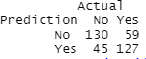
ACCURACY 71.19114
ERROR-RATE 0.2880886
Confusion Matrix

Slide 17
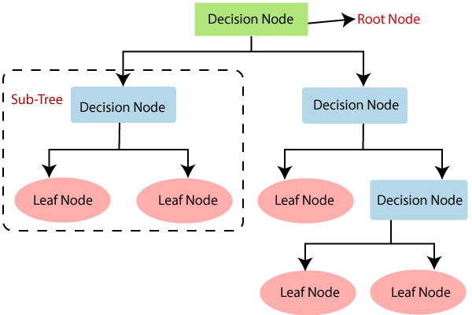
Decision Tree
Decision tree is a graph to represent choices and their results in form of a tree.
The decision tree classifier is a supervised learning algorithm which can use for both the classification and regression tasks.
The nodes in the graph represent an event or choice and the edges of the graph represent the decision rules or conditions.

Slide 18
Decision Tree
Decision Tree
Actual | No | Yes
No | 154 | 146
Yes | 20 | 40
ACCURACY | 53.88
ERROR RATE | 0.48

Slide 19
Random Forest
Random forest algorithm is a supervised classification and regression algorithm.
This algorithm randomly creates a forest with several trees. Generally, the more trees in the forest the more robust the forest looks like.
Similarly, in the random forest classifier, the higher the number of trees in the forest, greater is the accuracy of the results.

Slide 20
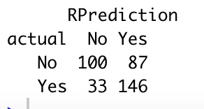
ACCURACY 67.213
ERROR-RATE 0.3240997
Confusion Matrix

Slide 21
Support Vector Machine
SVM is supervised learning used mostly for classification problems.
Effective in high dimensional spaces.
Makes use of a hyperplane which acts like a decision boundary between various classes

Slide 22
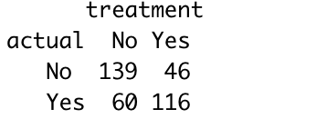
ACCURACY 70.63712
ERROR-RATE 0.2936288
Confusion Matrix

Slide 23
Logistic Regression
Regression analysis to conduct when the dependent data is categorical or binary
A statistical analysis method to predict a binary outcome, such as yes or no, based on prior observations of a data set

Slide 24
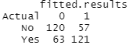
ACCURACY 66.759
ERROR-RATE 0.33241
Confusion Matrix

Slide 25
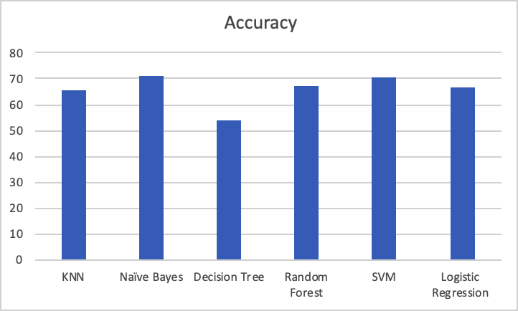
Comparison of Models by their Accuracy

Slide 26
Conclusion
Based on Accuracy as Evaluation metric, Naïve Bayes performs well

Slide 27
Thank You

